Slide 1
I Jornada de (d)Efecto Pasillo
Facultad de Ciencias, 15 junio 2018 #DefectoPasillo
II Plan de Promoción de la Investigación
Notes:
Drag Picture and Send to Back

Slide 2
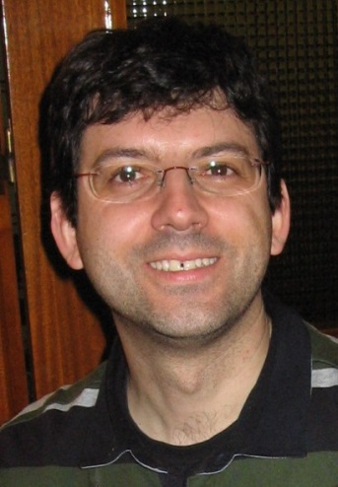
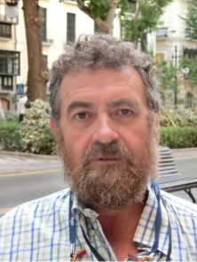
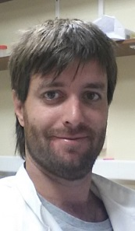
Laboratory of Surface and Interface Physics
Department of Applied Physics
Applied Physics
Outline
Since 1990…. Biomimetic bone-like coatings, colloidal assembly, waterproofing, road paving, adhesives, paints, imbibition, biomaterials
Disciplines: Surface physics and material engineering
Concepts: Durable functional coatings with low(high)-adhesion properties for real-life applications. Wetting and drop dynamics.
Deliverables: Release (demoulding) coatings, anti-icing coatings, anti-biofouling surfaces…
Dr. Miguel Ángel Rodríguez Valverde
Dr. Miguel Ángel Cabrerizo Vílchez
Dr. F. Javier Montes Ruiz-Cabello
http://wpd.ugr.es/~marodri/
mcabre@ugr.es
fjmontes@ugr.es
marodri@ugr.es
Wetting, adhesion, surface tailoring, roughness, durability
Jornadas (d)Efecto Pasillo Facultad de Ciencias

Slide 3
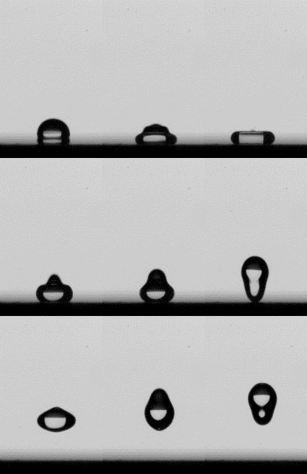
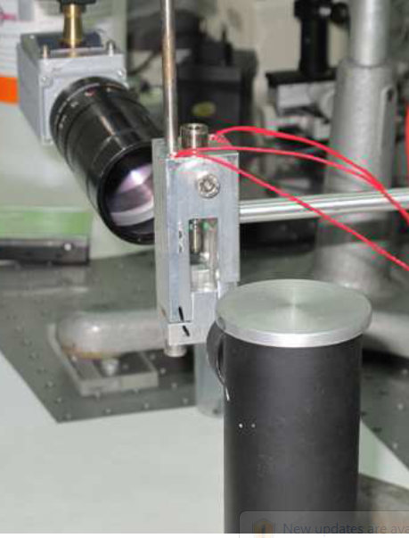
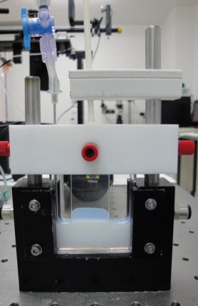
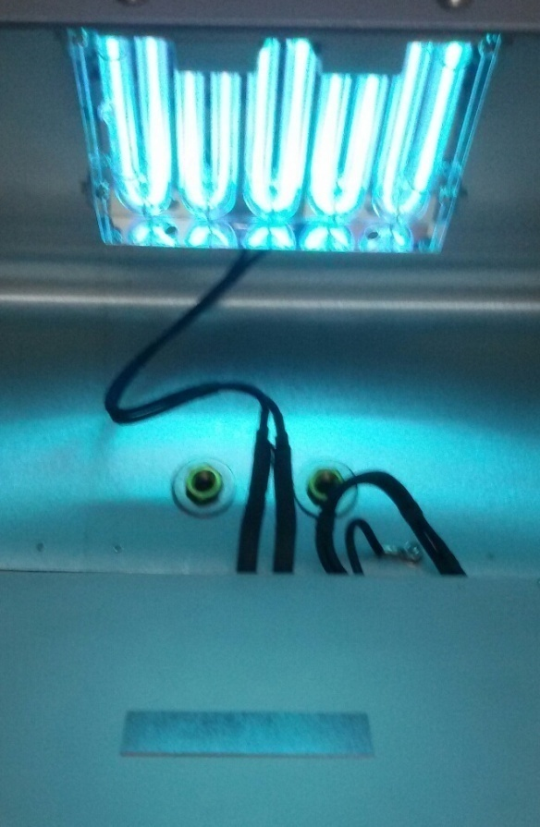
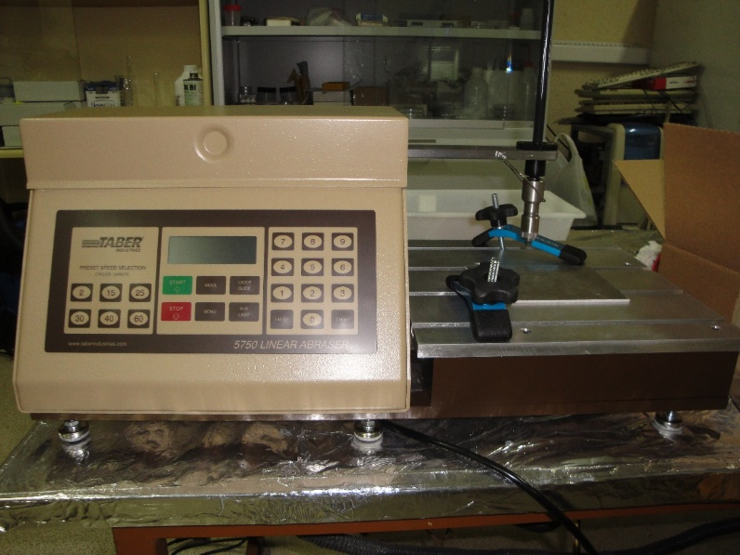
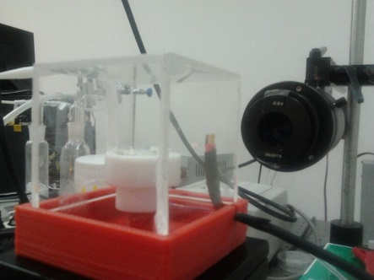
Laboratory of Surface and Interface Physics
Expertise
Adhesion and wettability.
Facilities and instrumentation
Wettability measurements
Adhesion (pull-off) tests
Dip-coating, spin-coating
Surface topography
Wear/abrasion tests, UV-Ozone
Prototyping of scientific instrumentation
Jornadas (d)Efecto Pasillo Facultad de Ciencias

Slide 4
Laboratory of Surface and Interface Physics
We need…
Physical vapor deposition (PVD) coatings
Infrared thermography (IRT) for freezing drops (~mm)
Water condensation measurement in/on small surfaces (Quartz Crystal Microbalance?)
Groups specialized on surface coatings: low surface energy, durability, scale-up, aeronautics…
for…
DISEÑO DE RECUBRIMIENTOS ANTI-ADHERENTES MEJORADOS
P12-FQM-1443
wpd.ugr.es/~nonsticky+
DESIGN AND PREPARATION OF LIQUID-REPELLENT SURFACES OPERATING IN EXTREME CONDITIONS
wpd.ugr.es/~repelsurf4xtrm
MAT2014-60615-R
FABRICATION OF LONG-LASTING LOW-ADHESION METAL-BASED SURFACES
MAT2017-82182-R
Current partners
TECNIMACOR, CETURSA, UCO, UYork
Jornadas (d)Efecto Pasillo Facultad de Ciencias

